Slide 1
NFL Running Back Performance and Social Media Presence
Beard, Napolitano, Sheffield, Wilson

Slide 2
Agenda
Hypothesis & Inspiration
Data Sources & Preprocessing
Transformation Methodology
Resulting Database
Distribution Plan
Shortcomings
Segregation of Duties

Slide 3
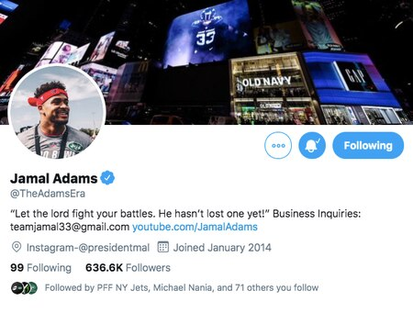
Hypothesis & Inspiration
How NFL players' game-by-game performance could impact and/or be impacted by their social media activity, following, and brand power.

Slide 4
Data Sources & Preprocessing
Data Source | Key Fields | Sourcing Method
NFL Game Schedule | Team matchups, game date, game time | SportsdataIO API
Player Twitter Activity | 'followers_count', 'favorite_count', 'retweet_count', 'created_at' | Twitter API
Player Performance | Fantasy Point Output | SportsdataIO API
Data Source Mapping Table | Player Name, Twitter Handle, SportsdataIO ID | Manual Exercise

Slide 5
Transformation Methodology
Player Twitter Activity
Player Performance
getTweets.ipynb
PlayerData.ipynb
Mapping Table
NFL Game Schedule
getNFLSchedule.ipynb
Output Table
NFLTwitterBack.ipynb

Slide 6
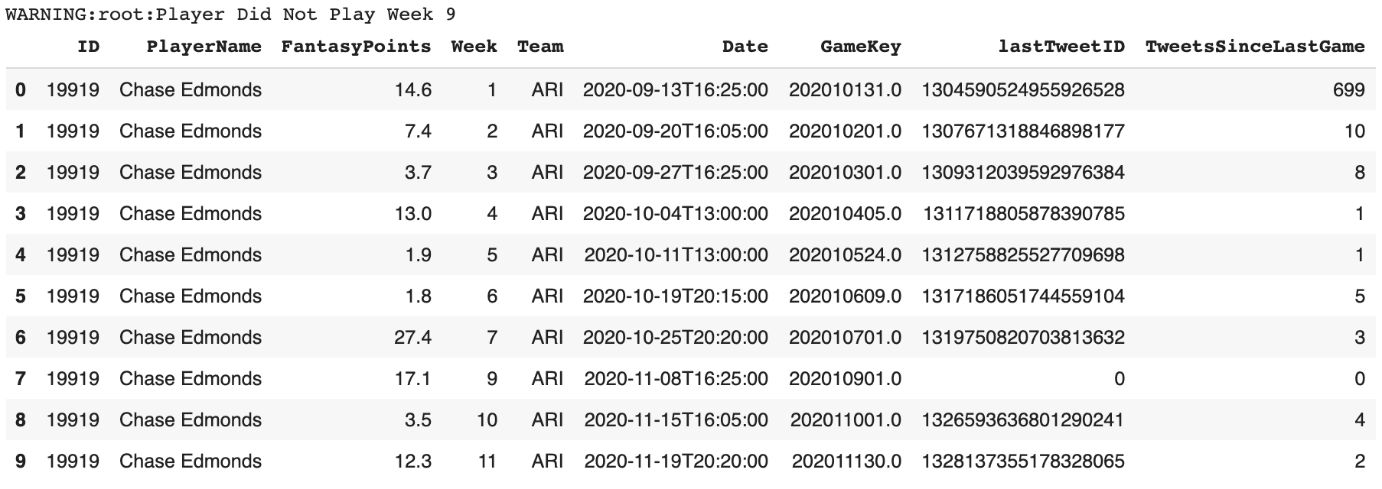
Resulting Dataframe

Slide 7

Distribution Plan
The database and programs are open to the public and available on GitHub via:
https://github.com/dtw19428/NFLTwitterBack.git

Slide 8
Shortcomings & Opportunities for Efficiency
Player trades/transactions
Paywall restrictions:
Twitter API rate limits
SportsDataIO statistic scrambling
Dependency on manual linking table
TweetsSinceLastGame (Super Bowl & Variable Week Length)
Timezones
Required Subdirectories

Slide 9
Segregation of Duties
Tyler Beard
Player Performance Scout
Andrew Napolitano
NFL Schedule Architect & Documentation Lead
Liz Sheffield
Data Transformation & Social Media SME
Dave Wilson
Distribution Lead
Built process flow to pull Running Back data from SportsDataIO API
Built process flow to pull NFL schedule from SportsDataIO API and created comprehensive README files
Built process flow to pull Twitter data from Twitter API and combine with Player Performance data and NFL game schedule data
Created distribution plan and data dictionary for seamless process usage for all

Slide 10
Thank you
Questions welcome!

